Slide 1
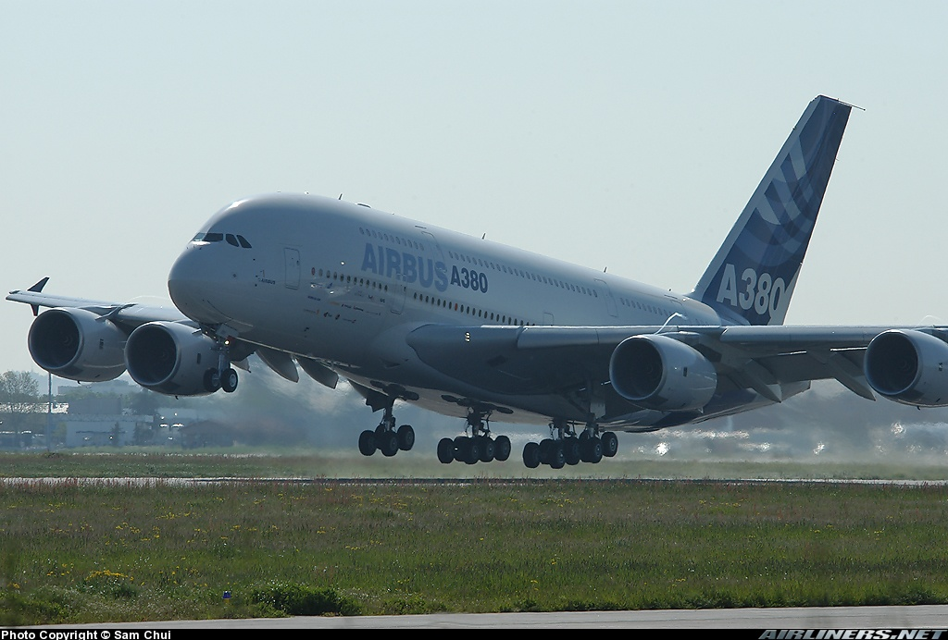
V. Take-off and landing performance
Notes:
V - <number>
Issue 1 – Feb 2011
V – Take-off and landing performance
This section is dedicated to take-off and landing performance.
In the first part, equations for ground roll are developed, then high lift configurations, used for take-off and landing are presented, before presenting take-off and landing performance.
Illustration : Airbus A380-800 at lift-off.

Slide 2
1. Ground roll
Forces acting on an airplane on ground
Z
V
x
F
X
Rsz₂
Rsz₁
Rsx₂
γ_{p}
Rsx₁
mg
z
Notes:
V - <number>
Issue 1 – Feb 2011
V – Take-off and landing performance
This slide presents the forces acting on an airplane on the ground.
In addition to weight, aerodynamic forces (lift and drag) and thrust, ground reactions must be accounted for.
The ground reactions acting on each individual wheel are noted Rsxi, Rsyi and Rszi, while global reactions (sum of reactions acting on all individual wheels) are noted Rsx, Rsy and Rsz.
Rsx is the tangential component, always positive, opposed to speed.
Rsy is the lateral component, positive to the right.
Rsz is the normal component, always positive, normal to the ground.
When aircraft is rolling on ground, the velocity vector is parallel to the ground. As a consequence, aerodynamic axis Gx is parallel to the ground.
In the aerodynamic reference system (Gxyz), the ground reactions components are :

Slide 3
1. Ground roll
Ground reactions
- Rsz
Normal reaction :
Rsz = mg - ½ρV² S Cz - Fz
Tangential reaction :
Rsx = μ Rsz
Friction coefficient μ depends on :
  Tire and runway surface (dry, wet, contaminated, …),
  Speed and relative slip speed (cf. next slide).
Notes :
  Conventions on the sketch : Rsx and Rsz are positive.
  Fz is usually neglected.
  For Rsx, one has to take into account the loads and friction coefficients for each individual wheel.
- Rsx
x
z
Notes:
V - <number>
Issue 1 – Feb 2011
V – Take-off and landing performance
Lift equation may be written as follows :
cosγ_{p} mg = ½ ρV²S Cz + Fz + Rsz
Usually, runway slope, noted γ_{p}, is small and its cosine may be approximated by 1, leading to the expression for Rsz (normal thrust component Fz is usually neglected, except when V/STOL aircraft are considered) :
Rsz ≅ mg - ½ ρV²S Cz
Rsz is always positive : if lift exceeds weight, the airplane becomes airborne.
The tangential reaction is a function of normal reaction (load on wheels) and of the friction coefficient.
Propulsion equation is : - n_{x} mg = Fx - ½ ρV²S Cx – Rsx
With :
and Rsx = μ Rsz = μ (mg - ½ ρV²S Cz)
The expression for acceleration (in « g ») is thus :

Slide 4
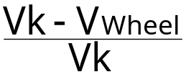
1. Ground roll
Braking : friction coefficient
Friction
coefficient
μ
Optimum
braking
Instability
0.5
Dry runway
Contaminated runway
0
0
1
Relative slip speed
Relative slip speed :
Vk is the A/C ground speed
V_{wheel} is the contact point speed
V_{wheel} = Ω.R_{w} (R_{w} is the wheel radius)
Ω
R_{w}
Vk
Notes:
V - <number>
Issue 1 – Feb 2011
V – Take-off and landing performance
This slide presents the evolution of friction coefficient as a function of relative slip speed.
The speed of the tire contact point is noted Vwheel. If the tire deformation is neglected, it may be considered as circular (constant radius Rw), leading to the following expression :
Vwheel = Ω.Rw Ω is the wheel rotation rate
Relative slip speed is the ratio between slip speed (Vk – Vwheel) and ground speed Vk. If the wheel is turning freely, Vwheel is equal to the aircraft ground speed Vk. Relative slip speed is zero.
As shown on the slide, friction coefficient increases when relative slip speed increases, until a maximum value is reached, then decreases slowly.
When pressure is applied on the brakes, wheel rotation rate decreases. As a consequence, relative slip speed increases, leading to an increase of tangential reaction : deceleration increases.
However, if too much pressure is applied and relative slip speed corresponding to optimum braking is reached, tangential reaction decreases. The consequence is a relative slip speed increase due to the decrease of A/C deceleration, leading to the blocking of the wheel (relative slip speed equal to one).
Comments continue on next slide.

Slide 5
1. Ground roll
Lift and drag :
  On ground, AOA is function of pitch attitude
  (α = θ - γp).
  Cx and Cz must take ground effect into account.
  Flaps/slats in take-off / landing configuration.
  Spoilers increase drag and decrease lift to increase load on wheels (landing/RTO).
Thrust :
  Maximum thrust/power for take-off.
  Idle thrust/power for landing (or rejected take-off), or reverse thrust when available.
Notes:
V - <number>
Issue 1 – Feb 2011
V – Take-off and landing performance
Continuation of previous slide comments
The blocking of the wheels is the consequence of an excessive brake pressure which should be avoided to maximize deceleration and keep good control.
Anti-skid systems are designed to avoid this phenomena by computing relative slip speed and releasing brake pressure when optimum value is reached. Relative slip speed is computed by measuring wheel turning rate and ground speed (from inertial reference system).
As shown on the slide, on contaminated runway (by standing water, snow, ice, etc), friction coefficient for free turning wheels increases, while maximum friction coefficient is much lower.
Comments of above slide
On ground, angle of attack is a function of pitch attitude only. When all wheels are on ground, A/C geometry defines the angle of attack.
Aerodynamic coefficients are functions of :
Ground effect, ground effect coefficient is the ratio between wing height above ground and wing span.
Aerodynamic configuration : flaps, slats, landing gear, spoilers, etc

Slide 6

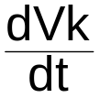



1. Ground roll
Expression for acceleration on ground
= -sinγ_{p} +
- ρV² Cx - μ_{e} (1- ρV² Cz)
Gravity
Runway slope
usually small
Drag
Function of AOA
(attitude on ground)
Ground effect
spoilers/airbrakes
for deceleration
Friction
μ_{e} depends on braking,
and runway state
For deceleration, Cz
should be smallest as
possible (spoilers)
Thrust to weight ratio
Max. thrust at T/O
Idle/reverse at landing
or aborted T/O
Notes :
  Normal thrust component is neglected.
  μ_{e} is an effective friction coefficient taking into account the loads on individual wheels and the braking actions (no brakes on nose landing gear)
Notes:
V - <number>
Issue 1 – Feb 2011
V – Take-off and landing performance
This slide presents the expression for acceleration on ground, from propulsion equation.
Runway slope is usually small, except for mountain airfields. However, the consequence of a 1 % positive slope is to decrease take-off acceleration by 0.01 « g » (and to increase deceleration of the same amount).
Maximum thrust is used for take-off, while engines should be kept at idle for deceleration (landing or aborted take-off),or reverse thrust used when available.
High drag configurations must be avoided for take-off, while aerodynamic drag may be used for deceleration.
For take-off, friction corresponds to the free wheel coefficient, while brakes are applied for deceleration. In the later case, lift should be kept as low as possible to maximize braking efficiency (high load on wheels). Mean friction coefficient takes into account the wheels not fitted with brakes (nose wheels).

Slide 7

1. Ground roll
Spoilers
Thrust reversers
Notes:
V - <number>
Issue 1 – Feb 2011
V – Take-off and landing performance
This slide presents devices used on large commercial airplanes to decelerate : spoilers and thrust reversers.
Spoilers increase drag and decrease lift, improving braking action. The effects of spoilers on deceleration may be expressed as follows :
In the above expression, ΔCx_{s} (drag coefficient increment due to spoilers deployment) is positive, while ΔCz_{s} is negative. Usually, on dry runways, the main consequence of spoilers deployment is the brake efficiency improvement.
On most recent commercial airplanes, spoilers are armed before landing as well as before take-off, in order to deploy automatically at touchdown and when aborting take-off.
Thrust reversers deviate exhaust jet, producing negative thrust. However, maximum negative thrust is usually must lower than maximum positive thrust. To avoid reingestion of hot gases by the engine, most thrust reversers must be used above a minimum speed. Due to their complexity, thrust reversers may be not sufficiently reliable for their influence to be taken into account for certified performance computations.

Slide 8
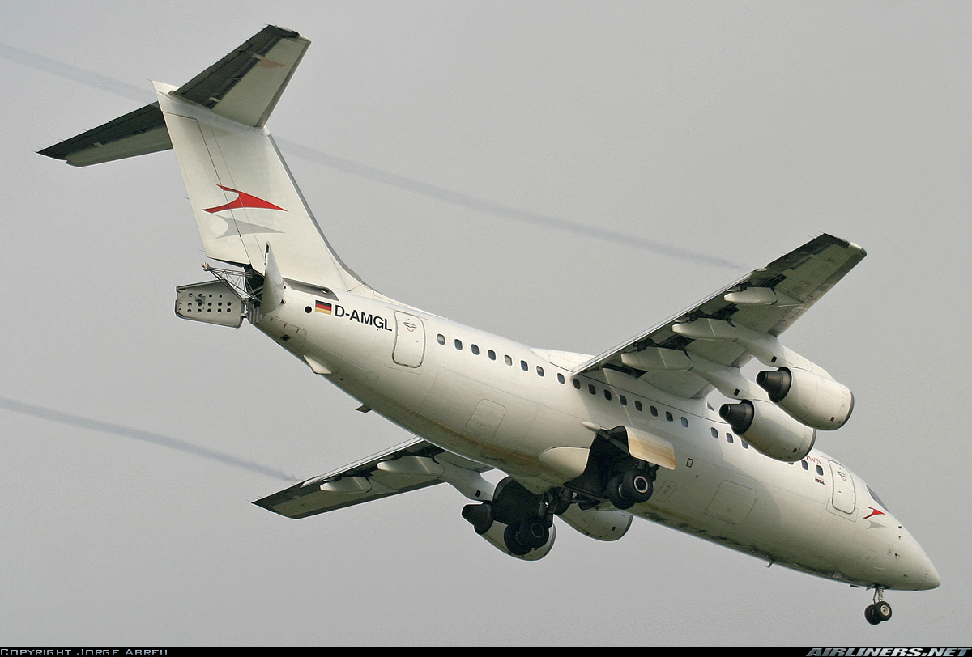
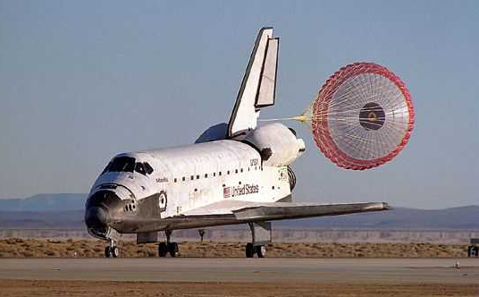
1. Ground roll
Aerodynamic braking
Airbrake
Split-rudder airbrake + parachute
Notes:
V - <number>
Issue 1 – Feb 2011
V – Take-off and landing performance
Airbrakes or parachutes are used for aerodynamic braking.
This slide presents the split rudder airbrake and the parachute that are used to assist Space Shuttle landing.
Airbrakes increase drag coefficient, with no influence on lift coefficient. Some commercial airplanes are fitted with airbrakes : British Aerospace Avro RJ (BAe 146) presented in the above slide and Fokker twin jets (F-28, F-70 and F-100) have « petal » airbrakes at the rear end of the fuselage.
Brake parachute deployment produce a much larger drag increase and are very efficient in terms of weight versus drag. However, brake parachutes are not compatible with commercial airplane operations : after landing, the parachute must be released before taxiing, then retrieved, and reconditioned before the next departure.

Slide 9
2. High lift configurations
The main goal is to increase maximum lift coefficient.
Other consequences :
  High drag increment : maximum Lift to Drag ratio decreases.
  Strong negative pitching moment (Cm0) is associated with flaps extension.
On most large commercial jet airplanes take-off and landing configuration combine flaps and slats deflections (larger deflections used for landing).
Notes:
V - <number>
Issue 1 – Feb 2011
V – Take-off and landing performance
High lift configurations are used for take-off and landing.
Take-off and landing performance are functions of :
Characteristic speeds (take-off speed, approach speed, etc).
Acceleration (take-off) or deceleration (landing, rejected take-off).
Since minimum speeds are function of stall speeds, when maximum lift coefficient increase, characteristic speeds decrease, improving take-off and landing performance.
However, since the drag increment due to flaps and slats deflection reduces acceleration as well as initial climb performance, take-off flaps and slats setting are usually lower than flaps/slats deflections for landing configurations.

Slide 10
2. High lift configurations
High lift devices : examples
Leading edge flap
Plain flap
Slot
Fowler flap
Slat
Double slotted flap
Notes:
V - <number>
Issue 1 – Feb 2011
V – Take-off and landing performance
Leading edge devices increase stall angle of attack (cf. slide presenting aerodynamic coefficients) :
A leading edge flap increases airfoil camber at leading edge, increasing « design » lift coefficient (lift coefficient for minimum airfoil drag) and maximum lift coefficient.
A slot increases maximum angle of attack through boundary layer blowing : at high angles of attacks, the flow coming from lower surface through the slot reenergizes the upper surface boundary layer.
The name « slat » comes from slot/flap combination.
Leading edge devices increase stall angle of attack with a small impact on pitching moment and drag. Not shown here is the kruger flap, which is more complex (cf. picture on next slide).
Trailing edge flaps increase lift at constant angle of attack; increasing maximum lift coefficient. Other consequences of flaps deflection are :
Drag penalty, increasing with flap deflection,
Strong nose down pitching moment increment.
It must be stressed that better high lift performance is usually obtained at the price of added weight and complexity

Slide 11
2. High lift configurations
Influence of slats/flaps deflection on lift coefficient
Cz
Slats
Cz
Flaps
Clean
ΔCz
Clean
α
α
Δα_{stall}
Consequences of slats deflection
on lift coefficient :
Stall AOA increment.
Small lift decrement at constant AOA.
Consequences of flaps deflection
on lift coefficient :
Small decrement of stall AOA.
Lift coefficient increment at constant AOA.
Notes:
V - <number>
Issue 1 – Feb 2011
V – Take-off and landing performance
This slide presents the influence of slats/flaps deflection on aerodynamic coefficients :
When slats are deflected, stall angle of attack increases.
When flaps are deflected, lift coefficient increases at constant angle of attack.
When flaps are retracted, lift coefficient decreases, and, as a consequence, normal load factor decreases at constant angle of attack.
When slats are retracted, the impact on lift coefficient is negligible is angle of attack is lower than « clean » stall angle of attack. However, above this angle of attack, the consequence of an inadvertent slats retraction may be a stall. To avoid slat retraction at high angles of attack, high lift system may be fitted with a slat locking system, based on angle of attack.

Slide 12
2. High lift configurations
Drag polars in high lift configurations
3.0
T/O configuration
2.5
Clean
configuration
2.0
Cz
1.5
1.0
Landing
configuration
0.5
0.0
0.00
0.10
0.20
0.30
0.40
Cx
Notes:
V - <number>
Issue 1 – Feb 2011
V – Take-off and landing performance
This slide presents drag polars in clean configuration, take-off configuration and landing configuration :
Maximum lift coefficient nearly doubles from clean configuration to landing configuration.
From clean configuration to landing configuration, drag increases very significantly. In landing configuration, maximum lift to drag ratio is lower than 50 % of the clean configuration L/D ratio.

Slide 13
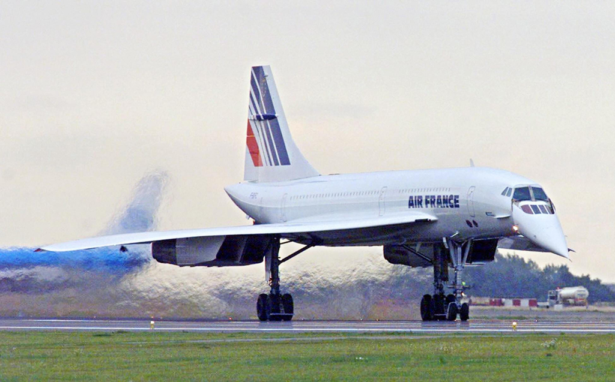
3. Take-off performance
Notes:
V - <number>
Issue 1 – Feb 2011
V – Take-off and landing performance
In the following slides, take-off performance are presented with some focus on commercial aircraft performance.
Illustration : Concorde at brakes release.

Slide 14
3. Take-off performance
Certified performance : in accordance to airworthiness regulations (FAR/CS 25, FAR/CS 23 … ).
Maximum take-off weight from a runway, in given conditions (weather, runway state, … ).
For FAR/CS 25, in case of one engine failure, the A/C should be able to :
  continue or abort T/O, with some safety margins,
  if take-off is continued, climb with some clearance from obstacles.
Notes:
V - <number>
Issue 1 – Feb 2011
V – Take-off and landing performance
Airworthiness regulations (FAR/JAR 25 for commercial airplanes) define take-off field length requirements.
This allows to determine the maximum take-off weight in given conditions :
Runway : altitude, length, slope, location relative to obstacles, etc
Weather conditions : temperature, atmospheric pressure, wind, etc
Runway state : dry, wet or contaminated (by standing water, snow, ice, etc).
Certified take-off performance are based on scenarios designed to guaranty a satisfactory safety level. Any change in those scenarios have an impact on certified take-off performance : as an example, lowering the 35 ft height margin at take-off would improve take-off performance figures without improvement on actual aircraft performance.
In this chapter, FAR/JAR 25 take-off performance are presented, since those requirements are more extensive than other requirements such as FAR/JAR 23. One of the basic rules, is that an engine failure may occur at any time without any prejudice to safety (multiple engine failures are not envisioned at take-off).

Slide 15
3. Take-off performance
FAR/CS 25 take-off (dry runway)
Take-off power/thrust. Slats/flaps in take-off configuration.
Nose landing gear on ground until VR (directional stability in case of engine failure).
Vk = 0
IAS = VR
rotation
IAS = VLOF
lift-off ( Vz >0 )
IAS ≥ V2
Gear up
35 ft
In case of engine failure : 1 second delay between VEF and V1
IAS = VEF
Engine failure
IAS = V1
Distance : TOD_{n-1} engine failure at VEF
Distance : TOD_{n} all engines operating
Notes:
V - <number>
Issue 1 – Feb 2011
V – Take-off and landing performance
This slide presents take-off distance definition according to FAR/JAR 25 regulations applicable to large commercial airplanes :
Take-off thrust power is applied on all engines at brake release.
Nose landing gear should be kept on ground until rotation speed, VR, is obtained (to maintain directional control in case of engine failure on ground).
Rotation begins at VR : lift increases with angle of attack, A/C is airborne at VLOF, when lift equals weight.
Acceleration continues until take-off safety speed, V2, is obtained.
V1 is the maximum speed at which take-off can be interrupted. In case of engine failure VEF is determined in relation to V1 (VEF is the speed obtained 1 second before V1).
In case of engine failure at speed VEF, take-off must be continued, using the same characteristic speeds VR and V2. Landing gear may be retracted after the airplane is airborne to lower the drag.
Take-off distance is from brake release to 35 ft height above the runway, at which IAS should be at least V2. TOD_{n} is the take-off distance with all engines operating and TOD_{n-1} the corresponding distance in case of engine failure at VEF. On wet runways, TOD_{n-1} is distance from brake release to 15 ft above the runway.

Slide 16
3. Take-off performance
Accelerate stop distance (dry runway)
FAR/CS § 25.109 (post amdt. 25.92/ Change 15)
First action to reject take-off at IAS = V1
Vk = 0
Vk = 0
2 s
at
V1
Max. braking
idle power / thrust
spoilers / airbrakes
Take-off power/thrust
all engines operating
margin
Accelerate-stop distance ASD
Notes:
V - <number>
Issue 1 – Feb 2011
V – Take-off and landing performance
According to current FAR/FAR 25 regulations (FAR amendment 25-92 and JAR change 15), the accelerate stop distance on dry runways is established as the sum of the distances necessary to :
Accelerate from zero speed to the highest speed reached during the rejected take-off, assuming the pilot takes the first action to reject the take-off at indicated airspeed V1 with all engines operating.
Come to a full stop, with engines all engines operating. Means other than brakes, such as spoilers or airbrakes, except reverse thrust, may be taken into account if proven as safe and reliable (on wet runways, if safe and reliable, reverse thrust may be included as an additional means of deceleration).
An additional distance corresponding to 2 seconds at IAS V1.
Notes :
Accelerate stop distance must also be demonstrated in case of engine failure at VEF (ASD_{n-1}), but this distance is usually lower than ASD_{n} (ASD is the greater of ASD_{n} and ASD_{n-1}. All engines operating demonstration is motivated by the fact that take-off may be aborted for reasons other than engine failures.
According to previous regulation (FAR amendment 42), instead of adding 2 seconds at V1, acceleration continued for 2 seconds after V1, before the beginning of braking action. Pre-amendment 42 regulations for accelerate stop distance were less stringent.

Slide 17
3. Take-off performance
FAR/CS 25 take-off field length
FAR/CS §25.113
On dry runway, take-off field length should be greater than :
  1.15 TODn, distance from start to 35 ft above runway elevation, all engines operating,
  TODn-1, distance from start to 35 ft, with critical engine failure at VEF,
  ASD, accelerate-stop distance.
Notes:
V - <number>
Issue 1 – Feb 2011
V – Take-off and landing performance
The above requirements for runway length apply to dry runways without clearway or stopway. A clearway is usable for the first segment (from rotation to 35 ft), while a stopway is usable for aborted take-off.
Take-off distance available (TODA) is the addition of runway length and clearway. Accelerate stop distance available (ASDA) is the addition of runway length and stopway (part of the runway usable only in case of rejected take-off). Take-off run available (TORA) is the distance available for take-off on the runway (without clearway and stopway).
The take-off run is defined as the distance from brake release to the point equidistant between the point where VLOF is reached and the point where 35 ft is reached. Take-off run is defined all engines operating (TOR_{n}) or with one engined failed at VEF (TOR_{n-1}).
Runway length requirements are defined as follows :
Dry runways TODA ≥ max. (1.15 TOD_{n}; TOD_{n-1})
Wet runways TODA ≥ max. (1.15 TOD_{ndry}; TOD_{n-1dry}; TOD_{n-1wet})
Dry runways TORA ≥ max. (1.15 TOR_{n}; TOR_{n-1})
Wet runways TORA ≥ max. (1.15 TOR_{ndry}; TOD_{n-1wet})
Dry/wet runways ASDA ≥ ASD
Note : On wet runways, TOD_{n-1wer} is established with a 15 ft height above runway, and iTOR_{n-1} is equal TOD_{n-1}. On wet runway, accelerate-stop distance must be at least equal to dry accelerate-stop distance.

Slide 18
3. Take-off performance
Take-off path (engine failure case) FAR/CS §25.111
Final segment
Clean configuration
Acceleration
in level flight
Flaps/slats
retraction
H ≥ 1500 ft AAL
2nd segment
CAS = V2
1st segment
Landing gear
retraction
H > 400 ft AAL
Lift-off
Max. continuous
thrust / power
Max. Take-off thrust / power
Notes:
V - <number>
Issue 1 – Feb 2011
V – Take-off and landing performance
This slide presents the take-off path in case of engine failure :
First segment begins at lift-off. It ends at 35 ft AAL (AAL stands for Above Airfield Level). Landing gear may be retracted during this segment.
Second segment begins at 35 ft. Speed must be maintained at V2. It ends at an altitude which must be higher than 400 ft AAL.
Second segment is followed by an acceleration in level flight, during which slats and flaps are retracted, until speed for best climb gradient in clean configuration.
Final segment is a climb in clean configuration to an altitude which must be higher than 1500 ft above the field. In final segment take-off thrust/power is reduced to maximum continuous rating.
Note : Minimum acceleration altitude is 400 ft AAL, a higher altitude may be defined. However, since take-off thrust (or power) use is limited according to powerplant limitations (usually 10 minutes in case of engine failure), maximum acceleration altitude is defined by this time (from take-off initiation to end of acceleration segment).

Slide 19
3. Take-off performance
One engine inoperative take-off path JAR/CS 25
Performance requirements : minimum climb gradients in take-off path segments (cf. table).
For jet airplanes, second segment requirement is usually the most critical one (low L/D ratio) :
  slats/flaps set for take-off,
  V2 in the region of reverse command.
Other requirement : 35 ft obstacle clearance with net take-off flight path.
Notes:
V - <number>
Issue 1 – Feb 2011
V – Take-off and landing performance
To ensure a safe climb in case of engine failure, airworthiness regulations (here FAR/JAR 25) define safety margins :
Minimum performance : minimum climb gradients (or equivalent climb gradients for acceleration segment), according to the number of engines (cf. next slide).
The obstacle clearance is defined in relation to the net take-off path (actual take-off path reduced by a 0.8 to 1. % climb gradient).

Slide 20
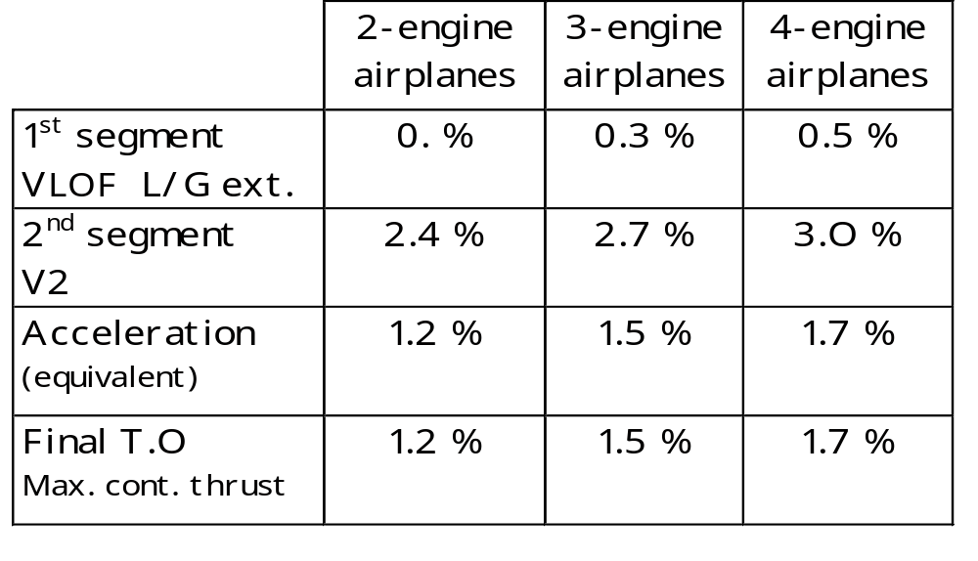
3. Take-off performance
FAR/CS 25 minimum climb gradients
one engine inoperative
Notes:
V - <number>
Issue 1 – Feb 2011
V – Take-off and landing performance
This slide presents the performance requirements according to the number of engines from JAR/FAR § 25.121.
Usually, the most stringent requirements are the second segment climb gradients.
Note : For first segment climb performance determination, ground effect is not taken into account.

Slide 21
3. Take-off performance
Take-off flight path (one engine failed)
FAR/CS §25.115
Net take-off
flight path
Gradient penalty :
2-engine A/C : 0.8 %
3-engine A/C : 0.9 %
4-engine A/C : 1.0 %
Actual take-off
flight path
H > 400 ft AAL
Min. 35 ft
Min. 35 ft
35 ft AAL
Gradient
penalty
Acceleration
penalty
Gradient
penalty
TOD_{n-1}
Notes:
V - <number>
Issue 1 – Feb 2011
V – Take-off and landing performance
This slide presents the take-off flight path in case of engine failure as defined in FAR/JAR § 25.125 :
The take-off flight path begins 35 ft above the runway at the end of one engine out take-off distance (TOD_{n-1}).
The net take-off flight path is obtained from take-off flight path, applying a climb gradient penalty which varies according to the number of engines (0.8 % for two-engine airplanes, 0.9 % for three-engine airplanes, 1.0 % for four-engine airplanes). This reduction in climb gradient may be applied as an equivalent reduction in acceleration.
According to operational regulations (FAR 121 and JAR OPS 1), the obstacle clearance for net take-off flight path must be at least 35 ft.
When establishing obstacle clearance, obstacles located in the take-off funnel, also called departure sector, must be taken into account.
Note : According to JAR-OPS 1, this clearance is increased to 50 ft when the horizontal trajectory requires turns exceeding 15° bank angle (according to FAR, maximum bank angle is 15°).

Slide 22
3. Take-off performance
Take-off characteristic speeds V1, VR, V2, …
Characteristic speeds are Calibrated airspeeds (≅ Equivalent Airspeeds).
For a given Equivalent airspeed EV, the corresponding ground speed Vk is :
  Vk = EV/√σ + Weff
  Weff is the effective wind (positive if tailwind)
For a given acceleration (deceleration) take-off distances increase when ground speeds corresponding to characteristic speeds increase.
Notes:
V - <number>
Issue 1 – Feb 2011
V – Take-off and landing performance
At low speeds and low altitudes, CAS may be approximated by EAS. This approximation is valid for take-off and landing.
The distance to accelerate from zero ground speed to lift-off is obtained by the following formula :
Distance from lift-off to 35 ft (at V2) may be deduced from total vertical speed and the total heights corresponding to VLOF and V2 :
As a first approximation, considering a constant acceleration Ax, take-off distance TOD_{n} is given by the following formula :

Slide 23
3. Take-off performance
V1 : maximum abort speed JAR/CS § 25.107
If braking action has not been initiated at V1, take-off should be continued.
VEF is related to V1 (1 second time delay to identify and react to a failure).
Minimum value for VEF is VMCG, minimum control speed on ground (in case of engine failure).
Maximum value for V1 : VMBE, maximum brake energy speed.
Notes:
V - <number>
Issue 1 – Feb 2011
V – Take-off and landing performance
V1 was previously called « decision speed », but this denomination is no longer used, since V1 marks the instant at which the pilot reacts to an engine failure, which supposes an earlier decision.
As per FAR/JAR § 25.107 : « V1 may not be less than VEF plus the speed gained with critical engine inoperative during the time interval between the instant at which the critical engine is failed, and the instant at which the pilot recognizes and reacts to the engine failure, as indicated by the pilot's initiation of the first action (e.g., applying brakes, reducing thrust, deploying speed brakes) to stop the airplane during accelerate-stop tests. »
If take-off is continued, in case of engine failure, directional control must be sufficient to maintain runway center line despite the thrust asymmetry. As a consequence, VEF must not be lower than VMCG, minimum control speed on ground. Since V1 is related to VEF through the one second delay, this requirement defines the minimum value for V1.
V1 must not exceed VMBE, maximum brake energy speed.

Slide 24
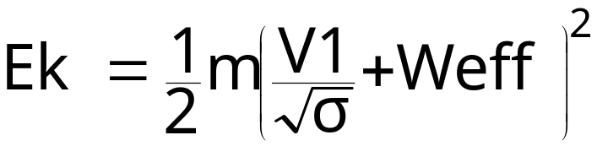
3. Take-off performance
VMBE : maximum brake energy speed
Kinetic energy at V1 is :
When take-off is aborted, the greatest part of Ek is converted into heat, generated by the brakes.
Maximum brake energy speed VMBE corresponds to maximum kinetic energy above which there is a risk of landing gear fire and tire burst.
Notes:
V - <number>
Issue 1 – Feb 2011
V – Take-off and landing performance
When braking, the greatest part of airplane kinetic energy is converted into heat in the brakes (some part is converted to heat into the ground, through wheel friction and a lesser part into heat to the air, through drag).
After a rejected take-off at high speed, the heat transfer into tires, wheels and landing gear, requires cooling by outside source (water mist), in order to avoid a fire.
Maximum energy is defined so as to allow sufficient time for ground crew intervention for brake and landing gear cooling. VMBE is the CAS corresponding to maximum brake energy.
Since VMBE corresponds to a constant kinetic energy :
VMBE is inversely proportional to the square root of mass,
VMBE is proportional to the square root of density, as a consequence it decreases with pressure-altitude and temperature.
Note : To limit the risk of tire burst due to high wheel temperature, commercial airplanes tires are filled with nitrogen and are equipped with fuses which depletes the tires when a maximum temperature is reached.

Slide 25
3. Take-off performance
VR : Rotation speed JAR/CS § 25.107
VR must be compatible with V1 and V2.
Directional control in case of engine failure VR ≥ 1.05 VMC
VR determines VLOF, speed at which the airplane becomes airborne. Minimum value for VLOF may define minimum value for VR.
VLOF ≥ 1.10 VMU all engines operative
VLOF ≥ 1.05 VMU one engine failed
Ground speed at VR ≤ max. tire speed.
Notes:
V - <number>
Issue 1 – Feb 2011
V – Take-off and landing performance
VR must be greater than V1 and lower than V2. Starting rotation at VR, with one engine failed, V2 must be obtained at or before reaching 35 ft above airfield level.
In case of an engine failure, it must be possible to maintain directional control after rotation (nose wheel off the ground). This explains the requirement for VR to be greater than VMC (minimum control speed in flight).
Lift off speed VLOF is a function of VR. Since VLOF must be greater than the minimum unstick speed, with sufficient margins, this defines also a requirement for the minimum value for VR.
Note : When VMU is defined by geometry (cf. slide about VMU), VLOF ratio may be reduced to 1.08 VMU with all engines operating (JAR 25 allows similar reduction to 1.04 VMU with one engine failed while FAR 25 maintains 1.05 ratio).
VMC and VMU are detailed on the next slides. It must be stressed that, as a first approximation, VMC does not depend on A/C weight.
The last requirement defines a maximum value for VR, at which ground speed must be lower than the maximum tire speed.

Slide 26
3. Take-off performance
VMC : minimum control speed JAR/CS §25.149
F
The yawing moment due to rudder deflection (and sideslip) must balance the moment due to engine failure :
½ ρ₀ EV² S l Cn₁ = Δy_{F}. F
VMC is the minimum CAS at which it is possible to maintain directional control in case of engine failure.
As a first approximation, VMC does not depend of A/C mass.
VMCG : Similar concept on ground.
Δy_{F}
Notes:
V - <number>
Issue 1 – Feb 2011
V – Take-off and landing performance
In aircraft reference system, the equation for yawing moment in case of left engine failure is :
½ ρ₀ EV² S l Cn_{1/G} = Δy_{F}. F_{R}
The yawing moment coefficient, Cn₁, is a function of rudder deflection and sideslip angle. The maximum value for this coefficient defines the minimum value for equivalent airspeed, VMC being the corresponding indicated airspeed.
For VMC demonstration, bank angle must be limited to 5° (which limits the sideslip angle) and full rudder may be applied (up to a maximum 150 lb rudder force whichever comes earlier).
As a first approximation, VMC does not depend on A/C mass, but VMC is a function of altitude and temperature since engine thrust decreases when altitude increases (VMC decreases when altitudes increases).
VMCG is the minimum control speed on ground, with nose landing gear in contact to the ground. VMCG is lower than VMC, due to better directional control. Note that VMC is sometimes called VMCA (« A » stands for « Air », as opposed to VMCG).
VMCL is the minimum control speed in landing configuration.
VMCL₋₂ is the minimum control speed in landing configuration with 2 engines failed on same side (4-engine airplanes).

Slide 27
3. Take-off performance
VMU : minimum unstick speed JAR/CS § 25.107 (d)
« VMU is the calibrated airspeed at and above which the airplane can safely lift off the ground and continue take-off. … »
θ_{max}
VMU may be limited by geometry : maximum pitch attitude on
ground defines maximum AOA (and lift coefficient) at lift-off.
Otherwise, VMU is limited by aerodynamics.
As a first approximation, VMU is proportional to the square root of A/C mass.
Notes:
V - <number>
Issue 1 – Feb 2011
V – Take-off and landing performance
VMU may be limited by aerodynamics or by geometry.
VMU is limited by aerodynamics (as well by thrust/power) when pitch attitude at VMU is lower than maximum pitch attitude on ground (limited by geometry).
VMU is limited by geometry when pitch attitude at VMU is the maximum pitch attitude on ground (at this pitch attitude, the aft fuselage is in contact with the ground).
This is usually the case for jet transports with stretched fuselages, since maximum pitch attitude on ground is under 15° while stall angle of attack may be higher than 20°, due to slats extension.
In this case, for the VMU demonstration, a tailskid is installed at the bottom of the aft fuselage to avoid damages. An early rotation is undertaken and maximum pitch attitude is maintained, with the aft fuselage in contact with the ground, until VMU is reached and the airplane becomes airborne.

Slide 28
3. Take-off performance
V2 : Take-off safety speed JAR/CS § 25.107
With the critical engine inoperative, at calibrated airspeed V2, the A/C should be able to climb safely with L/G retracted and flaps in T/O configuration.
V2 must be compatible with VR.
Minimum value V2_{MIN} is the greater of :
  1.20 Vs (or 1.13 Vs1g)
  1.10 VMC
V2 must be selected in order to provide at least the minimum climb gradient with one engine inoperative (cf. table).
Notes:
V - <number>
Issue 1 – Feb 2011
V – Take-off and landing performance
V2 must be selected in order to climb safely on second segment, with one engine failed (in take-off slats/flaps configuration, with landing gear retracted). This requires :
Speed margins relative to stall speed and minimum control speed. This defines the value for V2_{MIN}.
A minimum climb gradient.
Since stall speed is proportional to the square root of mass, while VMC does not depend on mass (as a first approximation), V2_{MIN} is equal to 1.10 VMC at lower weights.
In the case of jet engines, since V2_{MIN} is in the region of reverse command, the climb gradient increases when V2 increases (due to a higher lift over drag ratio). To improve climb gradient, V2 may exceed V2_{MIN}, but a higher value for V2 increases take-off distances.

Slide 29
3. Take-off performance
Maximum take-off weight may be limited by :
  runway length,
  still air climb gradient (2nd segment),
  obstacle clearance.
Runway length depends on :
  acceleration,
  deceleration (accelerate stop distance),
  ground speeds corresponding to characteristic speeds.
Obstacle clearance depends on :
  ground climb angle γk,
  one engine inoperative take-off distance.
Notes:
V - <number>
Issue 1 – Feb 2011
V – Take-off and landing performance
This slide presents the limitations affecting take-off performance and the factors that have a direct impact on those limitations.
As a first approximation, take-off distances are functions of :
All engines operating and one engine inoperative acceleration (and initial climb gradient when airplane is airborne),
Deceleration (accelerate stop distance),
Ground speeds corresponding to V1, VR and V2.
On engine inoperative climb gradient is a simple requirement, while obstacle clearance is more complex : it depends not only on climb gradient relative to the ground (taking into account the effective wind), but also the take-off distance.

Slide 30
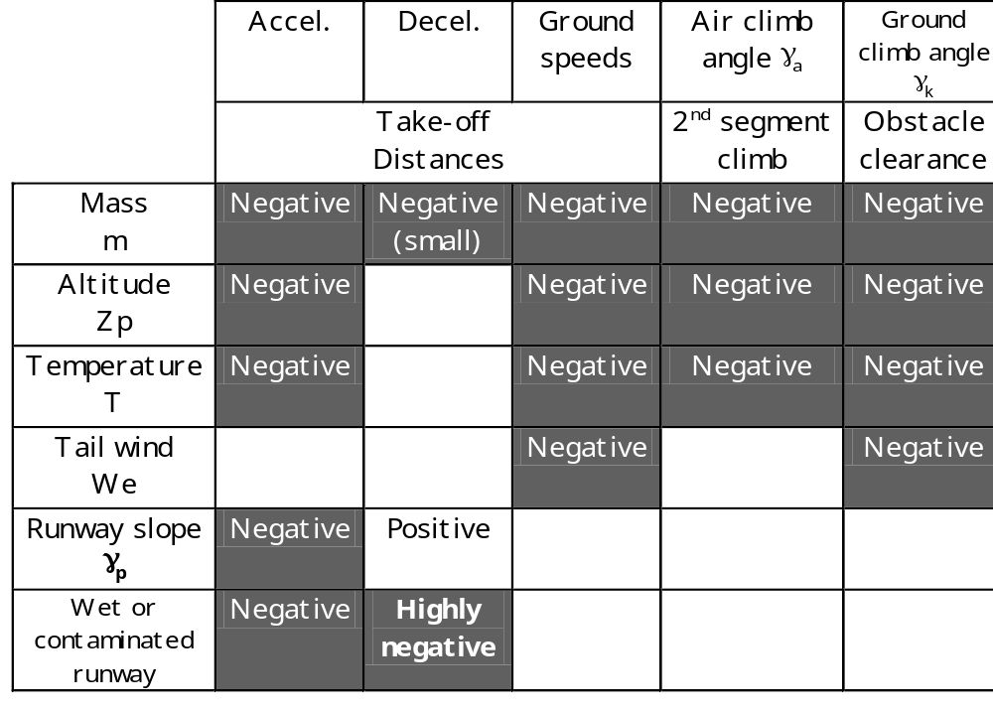
3. Take-off performance
Influence of parameters on take-off performance
Notes:
V - <number>
Issue 1 – Feb 2011
V – Take-off and landing performance
The term « negative » means that an increase of the parameter has a negative impact on take-off performance. The term « ground speeds » applies to ground speeds corresponding to characteristic speeds (V1, VR, V2, etc).
When mass increases, thrust to weight ratio decreases, with negative consequences on acceleration and climb gradient. Impact on characteristic speeds is also negative, due to the stall speed increment. Impact on deceleration may also be negative, when braking is limited by brake pressure, instead of being limited by friction coefficient.
Altitude and temperature have a similar influence on take-off performance : thrust decreases, with a negative impact on acceleration and climb gradient, and ground speeds corresponding to characteristic speeds increase, due to a lower air density.
The consequences of a tail wind is to increase ground speed for given airspeeds, with a negative impact on climb gradient relative to the ground.
A positive runway slope has a negative impact on acceleration and a positive impact on deceleration.
On wet or contaminated runway, braking action is reduced.

Slide 31
3. Take-off performance
Evolution of take-off weight limitation with altitude and temperature
Relative
T.O. limitation
ISA
1.10
1.00
0.90
0.80
0.70
0
2000
4000
6000
8000
10000
Pressure altitude (ft)
1.10
Relative
T.O. limitation
sea level
1.00
0.90
ISA temp.
at s.l.
0.80
Flat rating
temperature
0.70
0.60
-20
-10
0
10
20
30
40
50
temperature (° C)
Constant thrust
Notes:
V - <number>
Issue 1 – Feb 2011
V – Take-off and landing performance
This slide presents an example of take-off performance evolution with pressure altitude and temperature.
The relative take-off limitation is presented as a function of pressure altitude, in ISA conditions. The figure 1.00 corresponding to maximum take-off weight limitation at sea level, in ISA conditions.
This evolution is also presented as a function of temperature, at zero pressure altitude.
The evolution of take-off limitation as a function of pressure reflects both the thrust decrement and the ground speed increment (for constant characteristic speeds in terms of CAS, corresponding TAS increase when pressure altitude decreases).
The evolution of take-off limitation as a function of temperature presents two different slopes :
In this case, engines are « flat-rated » up to ISA+15°C, which means a constant thrust up to 30°C at sea level. Below this flat rating temperature, evolution reflects the TAS increase with temperature.
At higher temperatures, thrust decreases, leading to a higher impact on take-off performance.

Slide 32
3. Take-off performance
Take-off performance optimization : Flaps / slats settings.
When flaps and slats deflection increase :
  Lower value for Vs
  ⇒ lower value for V2
  Lower Lift/Drag ratio
  ⇒ negative influence on acceleration and
  climb gradient (2nd segment limitation).
Use of optimum flaps/slats setting according to runway length.
Notes:
V - <number>
Issue 1 – Feb 2011
V – Take-off and landing performance
Characteristic speeds V1, V2, VR may be selected according to take-off conditions (runway length, environment (obstacles), weather conditions, A/C mass, etc) in order to optimize take-off performance.
Characteristic speeds must respect constraints defined by airworthiness regulations.
Slats/flaps setting may also be selected in order to offer the best take-off performance.

Slide 33
3. Take-off performance
Take-off performance optimization : Balanced V1
Distance
Band for V1 value
when runway length
is greater than min.
Accelerate-stop
distance ASD
Minimum runway length
Take-off distance TODn-1
(one engine inoperative
at VEF)
V1 min
(VEF =VMCG)
Balanced V1
V1 max
(VR or VMBE)
V1
Notes:
V - <number>
Issue 1 – Feb 2011
V – Take-off and landing performance
This slide presents the « balanced V1 » concept.
V1 may be chosen between its minimum value (corresponding to VEF equal to VMCG), and its maximum value VR (V1 may be limited below VR, by maximum brake energy VMBE).
For given values for VR and V2, when V1 increases :
Accelerate stop distances (ASD) increases.
On engine inoperative take-off distance (TODn-1) decreases, since the airplane accelerates with all engines operating up to VEF (one second before V1).
The required runway length will be minimal when ASD = TODn-1. When runway length is greater than required runway length, V1 may be selected between a minimum value corresponding to the take-off distance limitation and a maximum value corresponding to accelerate stop distance limitation.
Note : When there is a stopway and/or a clearway, the difference between accelerate stop distance available (ASDA) and take-off distance available (TODA) must be taken into account to define balanced V1.

Slide 34
3. Take-off performance
Take-off performance optimization : V2 optimization
When V2/Vs increases above the minimum value V2min :
  Runway length increase,
  For jet airplanes, climb gradient increases.
  Best climb angle is obtained for speed close to best L/D, higher than 1.2 Vs.
Short runway length : V2 = V2min.
  Low take-off weight limitation : not limited by 2nd segment climb gradient.
Long runway length : V2 > V2min.
  Combined limitations : 2nd segment climb gradient and runway length.
Notes:
V - <number>
Issue 1 – Feb 2011
V – Take-off and landing performance
Except at very low take-off weights (when V2min equals 1.10 VMC), The minimum value for V2 is 1.20 Vs (or 1.13 Vs_{1g}).
In the case of a propeller airplane, this minimum speed is close to the best climb angle speed. However, in the case of jet airplanes, best climb angle is obtained for best lift over drag ratio, which corresponds to much higher speeds.
For V2 = V2min, if the runway is long enough, take-off weight may be limited by second second segment climb gradient limitation. In this case, a higher value for V2 may increase maximum take-off weight limitation, due to a better lift over drag ratio, at the expense of greater take-off distance.

Slide 35
3. Take-off performance
TOW
limitation
V2 optimization
V2 > 1.2 VS
increasing ratio
Combined
limitations
1.3 Vs 2nd segt. lim.
1.3 Vs
1.2 Vs 2nd segt. lim.
1.2 Vs
Runway length
limitation
for V2 = 1.3 VS
Runway
length
limitation
V2 = 1.2 VS
V2 = 1.1 VMC
Take-off distance available
Notes:
V - <number>
Issue 1 – Feb 2011
V – Take-off and landing performance
This slide presents the take-off weight limitation (performance limitation) as a function of take-off distance available.
The second segment climb limitation does not depend on runway length, and increases when the V2/Vs ratio increases (in this figure, the limitations for V2 = 1.2 Vs and V2 = 1.3 Vs are presented).
At very low weights, V2min is defined by VMCG and dot depends on weight. For fixed characteristic speeds, the weight limitation increases rapidly when take-off distance increases.
When the mass corresponding to V2min = 1.20 Vs is reached (1.20 Vs = 1.10 VMC), the take-off limitation increases more slowly when take-off distance available increases, since characteristic speeds increase when weight increases.
When second segment limitation is reached, the only way to increase take-off weight limitation when take-off distance increases, is to increase the V2/Vs ratio, which limits the benefits in terms of weight of an increase in take-off length available.
Note : In this case, we assume that balanced V1 may be selected, at higher weights, if maximum brake energy is obtained, V1 has to decrease when mass and speed increase, to maintain a constant total energy, and the gain in take-off weight limitation corresponding to a runway length increment is much smaller.

Slide 36
3. Take-off performance
Slats / Flaps settings optimization
When deflection increase (from flaps 1 to flaps 2) :
lower V2 ⇒ lower take-off distances at low weights
higher L/D ⇒ lower 2nd segment limitation for given
weight and V/Vs ratio
TOW
limitation
Flaps 1
Flaps 2
(deflection > flaps 1)
Take-off distance available
Short runways
optimum : flaps 2
Long runways
optimum : flaps 1
Notes:
V - <number>
Issue 1 – Feb 2011
V – Take-off and landing performance
This slide presents the take-off weight limitation (performance limitation) as a function of take-off distance available, for two slats/flaps settings (noted flaps 1 and 2).
Increasing slats and flaps deflections, from 1 to 2, has two consequences :
Maximum lift coefficient increases, stall speed decreases and take-off characteristic speeds decrease (lower V2_{min}).
For a given V2/Vs ratio, lift to drag ratio decreases, the consequence being lower climb angle.
On short runway, higher flaps/slats deflections offer better performance, due to lower characteristic speeds.
On longer runways, lower flaps/slats deflections offer better performance, due to better second segment performance.

Slide 37
3. Take-off performance
Slats / Flaps settings and obstacle clearance
Flaps 1
Higher slats/flaps deflections :
  Shorter take-off distance
  Lower climb gradient
Flaps 2
Notes:
V - <number>
Issue 1 – Feb 2011
V – Take-off and landing performance
When climb performance is constrained by obstacle clearance, in addition to second segment climb limitations, the optimization may be more complex. When the obstacle is close to the runway, high slats/flaps defections may offer better performance (due to shorter take-off distance) while low slats/flaps deflections may be optimum when obstacle is far from the runway, since they offer better initial climb performance.

Slide 38
3. Take-off performance
FLEX Temperature
TOW limitation
Max. TOW
Actual TOW
-20
0
20
40
Actual
SAT
Flex
Temp.
temperature (° C)
If actual weight is lower than max TOW corresponding to actual SAT, engine thrust may be reduced.
When a Flex temperature is set, take-off thrust is the maximum thrust at corresponding temperature. At any time, thrust may be increased to max. T.O thrust at actual SAT.
Use of Flex temperature lower engine maintenance costs.
Notes:
V - <number>
Issue 1 – Feb 2011
V – Take-off and landing performance
Flexible temperature (or flex as it is usually called) is a way to increase engine maintenance costs by reducing engine thrust. When engine thrust decreases, exhaust gases temperature (EGT) decreases as well as internal temperature, reducing thermal as well as mechanical stresses.
The principle for flex temperature is illustrated on the above slide. For a given runway, if actual take-off weight is lower than maximum take-off weight corresponding to the limitation, it is possible to reduce the thrust down to the temperature corresponding to the take-off limitation at the actual weight.
It must be stressed that :
At any time during the take-off, thrust may be increased to maximum take-off thrust (TOGA).
When using Flex thrust, a margin is retained since the limitation for flex temperature takes into account the thrust reduction due to temperature as well as the true airspeed increment due to temperature increment (using the same characteristic speeds, true airspeeds will be lower, generating some safety margin).
Regulations authorize up to 25 % thrust reductions (relative to maximum take-off thrust).
Flex thrust is not authorized on contaminated runways.

Slide 39
3. Take-off performance
Derated thrust
Derated thrust is equivalent to the use of engines certified for a lower thrust :
  When derated thrust is used, T.O. thrust is decreased by x % (Example : D 08 means T.O. thrust decreased by 8 %).
  Lower VMC and VMCG, corresponding to derated thrust
  In case of engine failure, thrust cannot be increased until slats/flaps retraction.
When characteristic speeds are constrained by VMC or VMCG, derated thrust may improve performance.
Notes:
V - <number>
Issue 1 – Feb 2011
V – Take-off and landing performance
Derated thrust is different from flex temperature reduction. Take-off performance are established using a take-off thrust reduced by a fixed percentage.
While Flex temperature is used to decrease maintenance costs, derated thrust may be useful, in some cases, to improve take-off performance.
When characteristic speeds (V1, VR, V2) are constrained to their minimum values by minimum control speeds (VMC and VMCG), derated thrust may be used to decrease characteristic speeds through the reductions in VMC and VMCG, from thrust reduction. On wet or contaminated runways, the benefit from lower characteristic speeds may be greater than the penalty due to thrust reduction.
It must be stressed that :
Due to the impact on VMC and VMCG, thrust may not be increased to maximum take-off thrust (TOGA) until acceleration.
While flex temperature must not be used on contaminated runways, derated thrust may be used on contaminated runways since it may provide performance improvements in those situation.

Slide 40
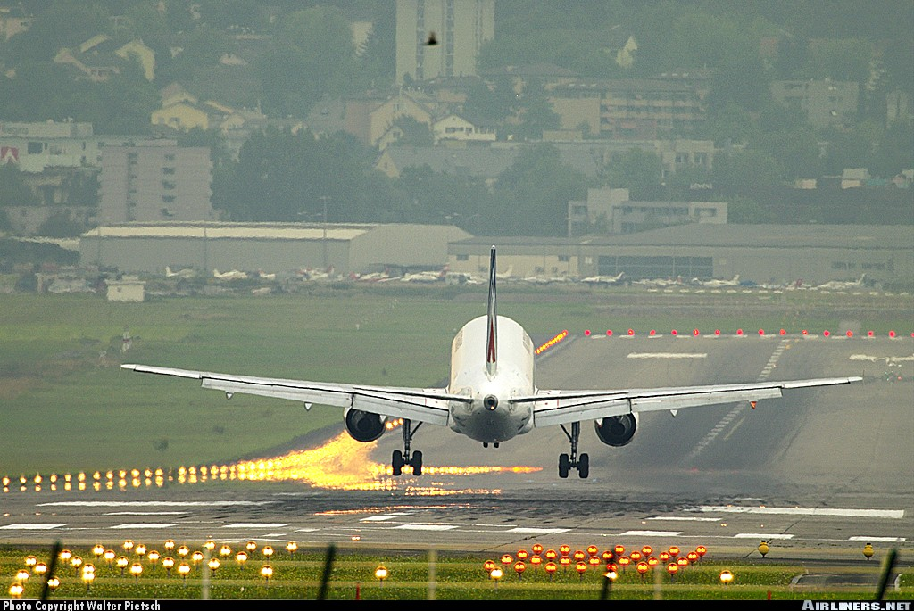
4. Landing performance
Notes:
V - <number>
Issue 1 – Feb 2011
V – Take-off and landing performance
In the following slides, landing performance are presented, with a focus on large commercial airplane performance, according to FAR/JAR 25 regulations.
Illustration : Airbus A320 at flare

Slide 41
4. Landing performance
FAR/CS 25 Landing distance
IAS = VREF
Main landing
gear impact
Nose landing
gear impact
Vk = 0
50 ft
Flare
Roll out
Derotation
Landing distance
Notes:
V - <number>
Issue 1 – Feb 2011
V – Take-off and landing performance
This slide presents the principle for establishing landing distance under FAR/JAR 25 regulations :
Airplane is initially stabilized on approach, under a standard 3° (5 % slope) at a speed not lower than VREF, which is the minimum approach speed (1.30 Vs_{min} or 1.23 Vs_{1g} according to the stall speed definition).
Runway threshold must be overflown at 50 ft (15 m) height. Power/thrust may be reduced to idle at 50 ft. Flare is the transition phase between stabilized approach and touchdown.
After main landing gear impact, derotation is undertaken to put nose landing gear in contact with the ground.
Then, deceleration is undertaken, using maximum brake efficiency.
Note : Approach speed must not be lower than VMCL (minimum control speed in landing configuration).

Slide 42
4. Landing performance
FAR/CS 25 Landing distance
Stabilized approach until 50 ft AAL :
  3° slope
  landing configuration
  power/thrust set for constant CAS = VREF
  VREF = 1.30 Vs (1.23 Vs1g) in landing configuration
At 50 ft AAL, thrust/power may be retarded to idle.
Purpose of flare is to reduce vertical speed for impact : maximum vertical speed for structural design is 600 ft/mn at maximum landing weight (360 ft/mn at max. take-off weight).
Notes:
V - <number>
Issue 1 – Feb 2011
V – Take-off and landing performance
In presenting the principles under which FAR/JAR 25 landing distances are established, it must be stressed that day to day operations may differ from those principles.
Minimum approach speed is 1.30 Vs_{min} or 1.23 Vs_{1g}. On approach, there should be a sufficient margin relative to stall in case of wind shear or other atmospheric disturbances. In normal operations, approach speed is usually greater than VREF, with a minimum 5 kt margin.
Maximum vertical speed is 600 ft/mn (10 ft/s) at touchdown
(360 ft/mn – 6 ft/s over maximum landing weight). In normal operations, vertical speed at touchdown is lower than maximum values, for better comfort.
As a consequences, flare distances established under FAR/JAR 25 landing may be considered as minimum values instead of normal values. This justify the margin between certified landing distances and landing field lengths requirements under operational regulations.

Slide 43
4. Landing performance
FAR/CS 25 Landing distance
Deceleration : means other than brakes may be used if proven as “safe and reliable”.
  Usually, thrust reverser use is not taken into account for landing distance determination.
Runway length requirements are defined by operational regulations (OPS 1 example below) :
  Runway length ≥ Certified landing distance / 0.6
  (0.7 for turboprops)
This safety margin is motivated by flare dispersion in normal operations.
Notes:
V - <number>
Issue 1 – Feb 2011
V – Take-off and landing performance
For jet airplanes, certified landing distance is usually established without taking into account reverse thrust (engines at idle thrust). In the case of turbopropeller airplanes, influence of reverse pitch is usually taken into account, being more reliable than reverse thrust on jet engines.
Certified landing distances are established without taking reverse thrust into account, but most jet transports are equipped with thrust reversers. The use of reverse thrust in normal operations reduces brake wear (kinetic energy absorbed by brakes is reduced and brakes temperatures after landing are lowered).
It must be stressed that, braking action is poor on contaminated runways, and reverse thrust influence is more important than on dry runways.
According to most operational regulations, runway length (landing distance available) must be at least 66 % greater than certified landing distance. This allow to take into account several factors that may increase landing distance in normal operations, the more important being distance from 50 ft to touchdown.

Slide 44
4. Landing performance
Landing configuration : slats/flaps
When slats/flaps deflection increase, landing distance is reduced :
  lower stall speeds ⇒ lower approach speeds
  high drag means lower flare distances
However, deflection may be limited by other considerations :
  Approach noise level (higher drag means higher thrust/power in approach),
  Go around climb performance.
Notes:
V - <number>
Issue 1 – Feb 2011
V – Take-off and landing performance
The minimum landing distances are obtained using maximum flaps/slats deflections, in order to have the maximum lift coefficient (for minimum approach speeds). A high drag in landing configurations helps reducing landing distance, mainly due to shorter flare distances (when thrust is retarded to idle at 50 ft).
However, in addition to noise level requirements, JAR/FAR 25 require minimum climb gradients in case of go-around :
In landing configuration (slats/flaps deflection used for landing, landing gear down), all engines operating, the steady climb gradient should be at least 3.2 % (§ 25.119 Landing climb, all engines operating).
Note : Climb speed must be not greater than 1.30 Vs and power/thrust is thrust available 8 seconds after moving power/thrust controls from flight idle to take-off position.
With on engine failed, in approach configuration (climb gradient should be at least (§ 25.121 Climb, one engine inoperative (d) approach) 2.1 % or two-engine A/C, 2.4 % for three-engine A/C and 2.7 % for four-engine A/C, with remaining engines at take-off power/thrust.
Note : Stall speed for approach configuration (L/G retracted) must be lower than 1.1 Vs for landing configuration.

Slide 45
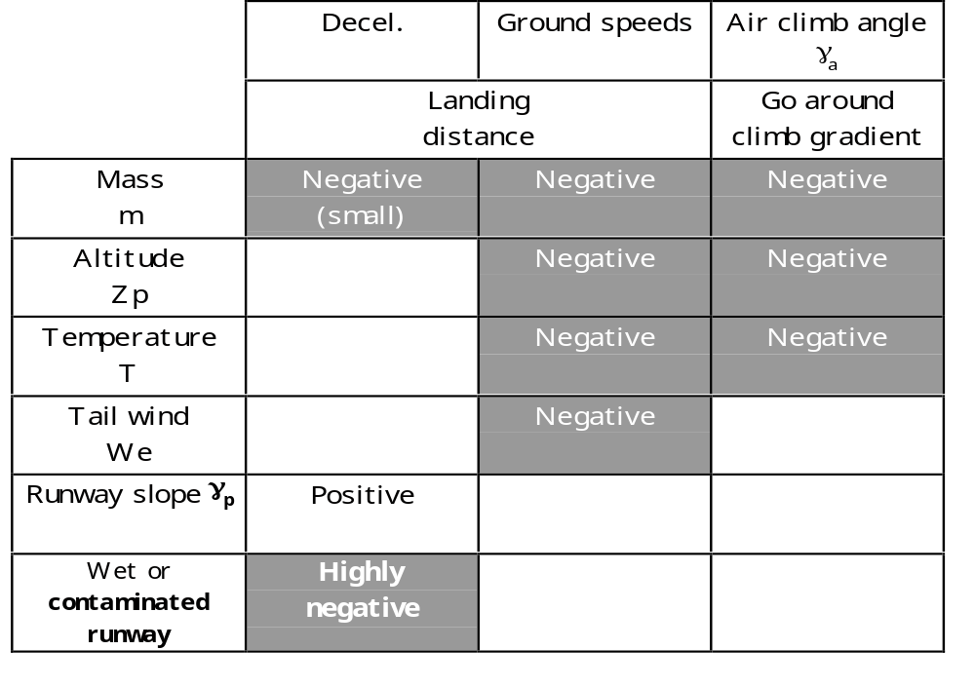
4. Landing performance
Influence of parameters on landing performance
Notes:
V - <number>
Issue 1 – Feb 2011
V – Take-off and landing performance
The term « negative » means that an increase of the parameter has a negative impact on take-off performance. The term « ground speed » applies to ground speed corresponding to VREF.
When mass increases, VREF increases. Thrust to weight ratio decreases, with negative consequences on go-around. Impact on deceleration may also be negative, when braking is limited by brake pressure, instead of being limited by friction coefficient.
Altitude and temperature have a similar influence on landing performance : ground speed corresponding VREF increase, due to a lower air density and thrust decreases, with a negative impact on go-around climb gradient.
The consequences of a tail wind is to increase ground speed for given airspeeds, with a negative impact on climb gradient relative to the ground.
A positive runway slope has a positive impact on deceleration.
On wet or contaminated runway, braking action is reduced.

